Slide 1
Live Migration of VM and its Parallelization
October 30, 2019
Xingguo Jia

Slide 2
Why VM Migration
Avoid difficulties faced by process-level migration (residual dependencies)
In-memory state can be transferred in a consistent and (as will be shown) efficient fashion (Both user and kernel level state)
Separation of concerns between users and operator of cluster
Allow maintenance of physical host
Load balancing and power management
Fault tolerance

Slide 3
Challenges for Live Migration of VM
Should be completed in a timely manner to
Avoid disruption and performance degradation of running services
Avoid SW/HW faults to cause VM crash (and crash of the whole cluster)
Amount of resources allocated to a VM is increasingly large
Extra Large VM instances in Amazon EC2: 68.4 GByte memory
Virtualized database servers: 10X Gbytes memory
Degrade the performance of other co-located VMs
Network bandwidth contention
High CPU usage
Security issues

Slide 4
Related Work
Umesh Deshpande(IBM research), Danny Chan, Steven Chan, Kartik Gopalan, Nilton Bila: Scatter-Gather Live Migration of Virtual Machines.
IEEE Trans. Cloud Computing 6(1): 196-208 (2018)
The source scatters the memory of VMs to multiple nodes, including the destination and one or more intermediaries.
Eviction from the source is no longer bottlenecked by the reception speed of the destination
reduces the eviction time by up to a factor of 6 against traditional

Slide 5
Related Work
Umesh Deshpande(IBM research), Kate Keahey: Traffic-sensitive Live Migration of Virtual Machines.
Future Generation Comp. Syst. 72: 118-128 (2017)
traffic-sensitive live VM migration technique to reduce the contention of migration traffic with the VM application traffic
base the selection of migration techniques(pre/post-copy) on the VMs’ network traffic profiles
Minimizes the network contention for migration

Slide 6
Related Work
Fengzhe Zhang, Haibo Chen: Security-Preserving Live Migration of Virtual Machines in the Cloud.
J. Network Syst. Manage. 21(4): 562-587 (2013)
Extend hypervisor-based process protection systems with live migration capabilities by migrating the protection-related metadata maintained in the hypervisor together with virtual machines
Protecting sensitive user contents using encryption and hashing.
Degradation in terms of both total migration time and downtime are reasonably low compared to the unmodified Xen live migration system.

Slide 7
Related Work
J. T. Peter Sva ̈rd, Benoit Hudzia and E. Elmorth.
Evaluation of delta compression techniques for efficient live migration of large virtual machines.
In Proceeding of the ACM SIGPLAN/SIGOPS International Conference on Virtual Execution Environments, 2011.
Using delta compression for minimized memory data size

Slide 8
Basic concepts
Live Migration of Virtual Machines (NSDI ’05)
Christopher Clark, Keir Fraser, Steven Hand, Jakob Gorm Hansen†, Eric Jul†, Christian Limpach, Ian Pratt, Andrew Warfield
University of Cambridge Computer Laboratory 15 JJ Thomson Avenue, Cambridge, UK , Department of Computer Science University of Copenhagen, Denmark
Implemented on Xen

Slide 9
Process migration
Migrate running processes using a network to another machine and continue its execution there
Problems: Residual Dependency
I/O, IPC redirection
Redirect migrated process’s I/O requests and IPC to original host
Memory emulation
Use the network to emulate memory segments
No simple task, high overhead, easy to crash due to network partition
VM migration: Simple and robust

Slide 10
Virtual resources to migrate for VM
Memory
Network, disk
CPU states
VM specific states

Slide 11
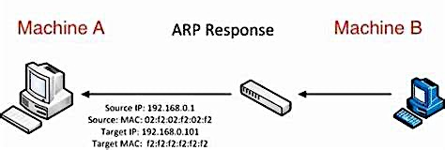
Network resources
Unsolicited ARP reply broadcast from the migrated -> let others know the new MAC address
If aware of migration, only reply to connected hosts

Slide 12
Disk
Network-attached storage (NAS)
Simple centralised administration
Robust
Obviates the need to migrate disk storage

Slide 13
Memory
A conservative pre-copy approach
Stage 0: Pre-Migration preselect dst host
Stage 1: Reservation allocate resources on dst host
Stage 2: Iterative Pre-Copy iteratively send src pages to dst
Stage 3: Stop-and-Copy suspend src, send all mem pg, states
Stage 4: Commitment dst reply to src for receiving, src discard VM
Stage 5: Activation send ARP, reattach NAS, start running on dst
At any step, an intact VM instance must exist
stg1 – stg5 = total migration time
stg3 – stg5 = downtime

Slide 14
How to track dirty pgs of prev iteration?
Dirty bitmap
At the beginning of iter, set all PTE of shadow pgt read-only
Guest writes a page, causing pg fault, trapped by Xen
Extend permission to the shadow PTE from guest PTE
Record in dirty bitmap
Send pgs in dirty bitmap
At the end of iter, set dirty bitmap empty

Slide 15
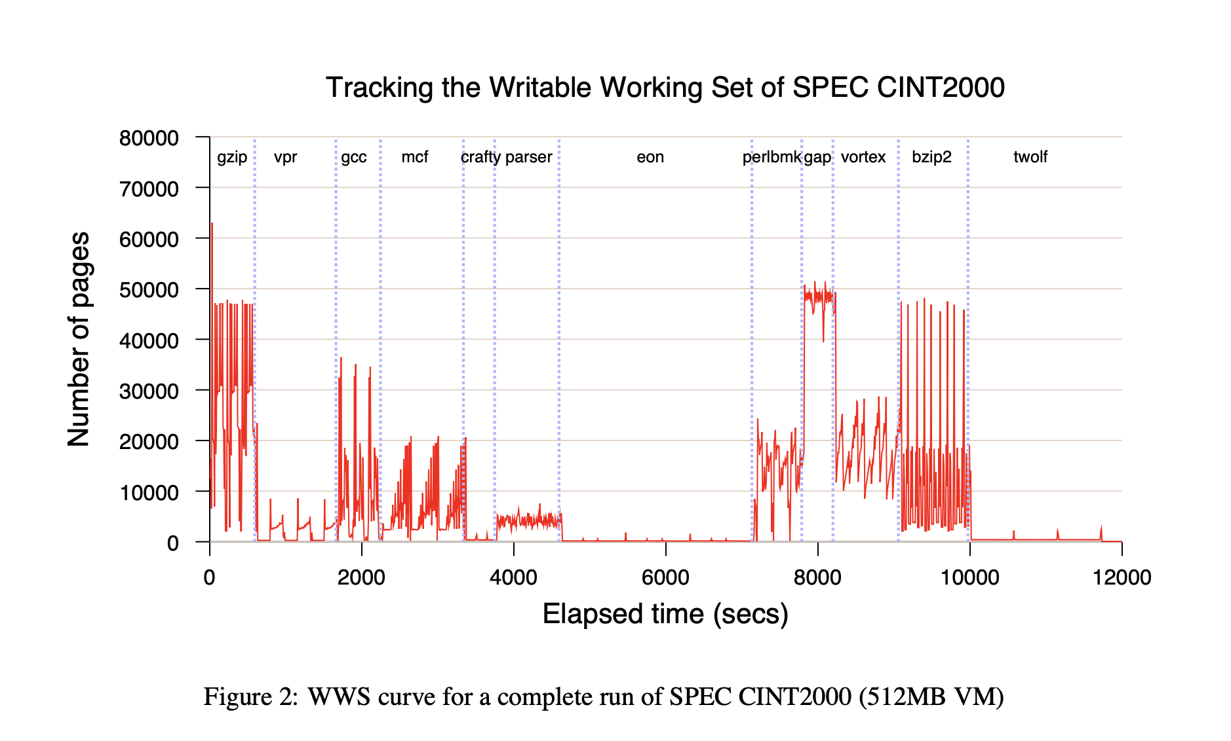
When to stop pre-copy iteration?
writable working set (WWS)
Pgs that are written often and so should best be transferred in stg 3
Different for different workloads

Slide 16
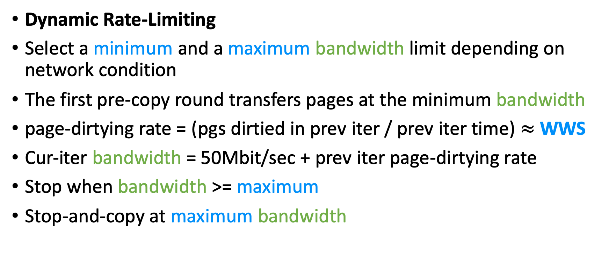
When to stop pre-copy iteration?
Dynamic Rate-Limiting
Select a minimum and a maximum bandwidth limit depending on network condition
The first pre-copy round transfers pages at the minimum bandwidth
page-dirtying rate = (pgs dirtied in prev iter / prev iter time) $≈$ WWS
Cur-iter bandwidth = 50Mbit/sec + prev iter page-dirtying rate
Stop when bandwidth >= maximum
Stop-and-copy at maximum bandwidth

Slide 17
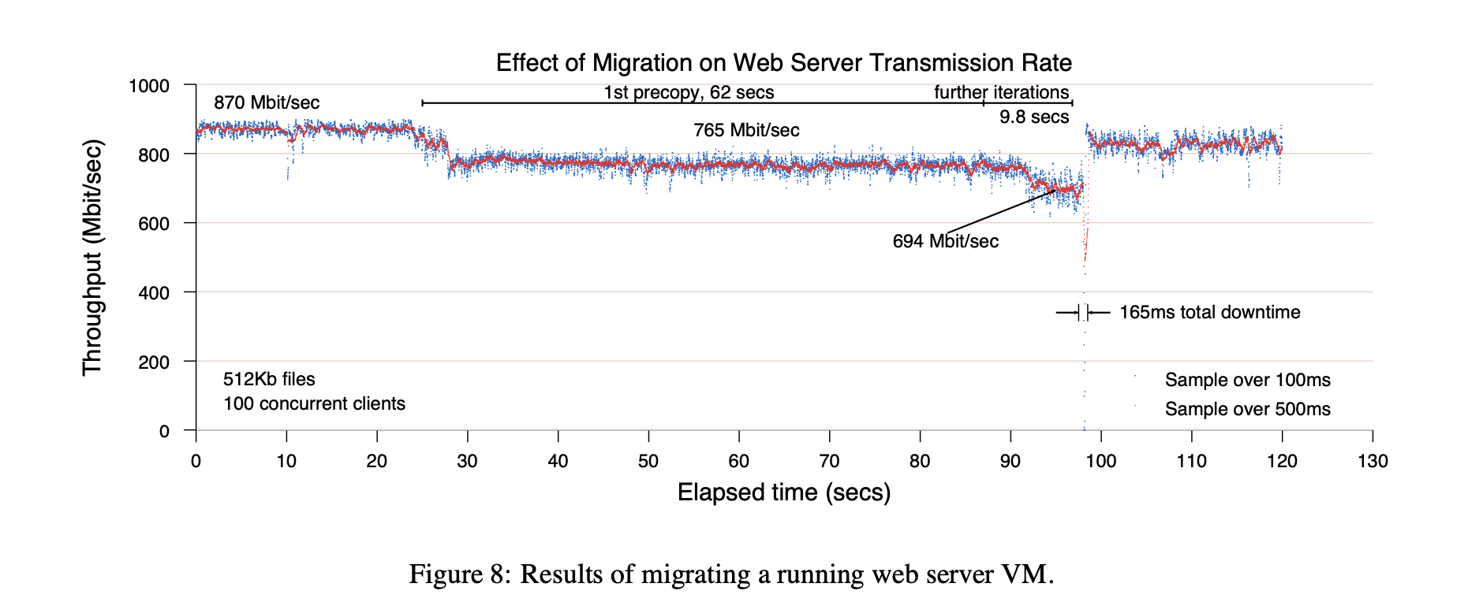
Evaluation

Slide 18
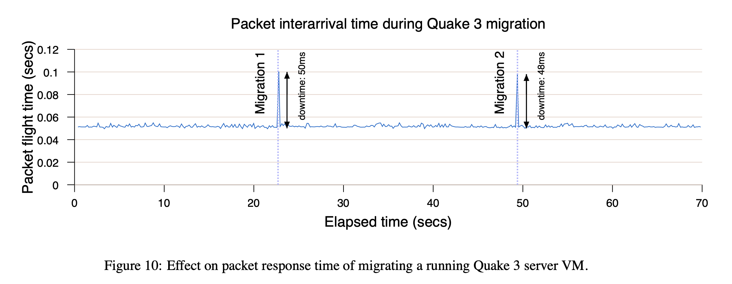
Evaluation

Slide 19
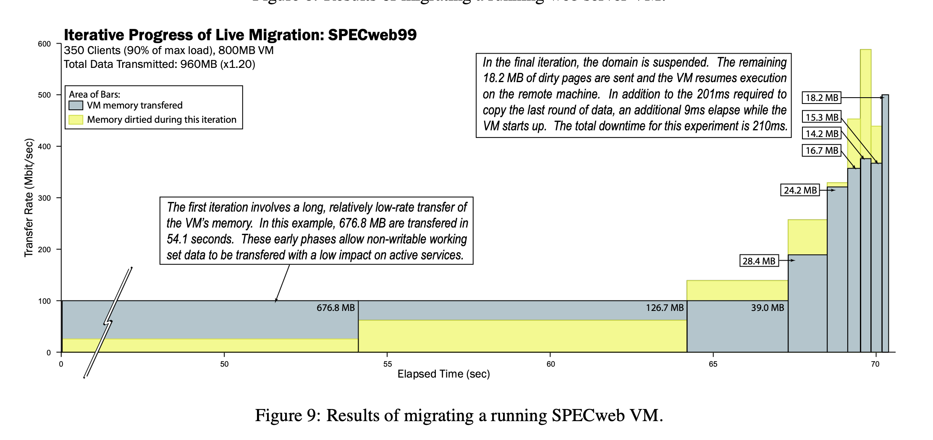
Evaluation

Slide 20
Parallelization
Parallelizing Live Migration of Virtual Machines(VEE’13)
Xiang Song † ‡ Jicheng Shi† ‡ Ran Liu † ‡ Yang Jian† ‡ Haibo Chen†
†Institute of Parallel and Distributed Systems, Shanghai Jiao Tong University ‡Software School, Fudan University
Implemented on Xen and QEMU-KVM
Named PMigrate

Slide 21
Motivation
Abundant resource of current data centers and cloud, not having been fully utilized
Dozens of CPU cores
Hundreds of Giga-bytes memory
A dozen of NIC ports
Parallelization opportunities of the live VM migration
Data parallelism
Pipeline parallelism

Slide 22
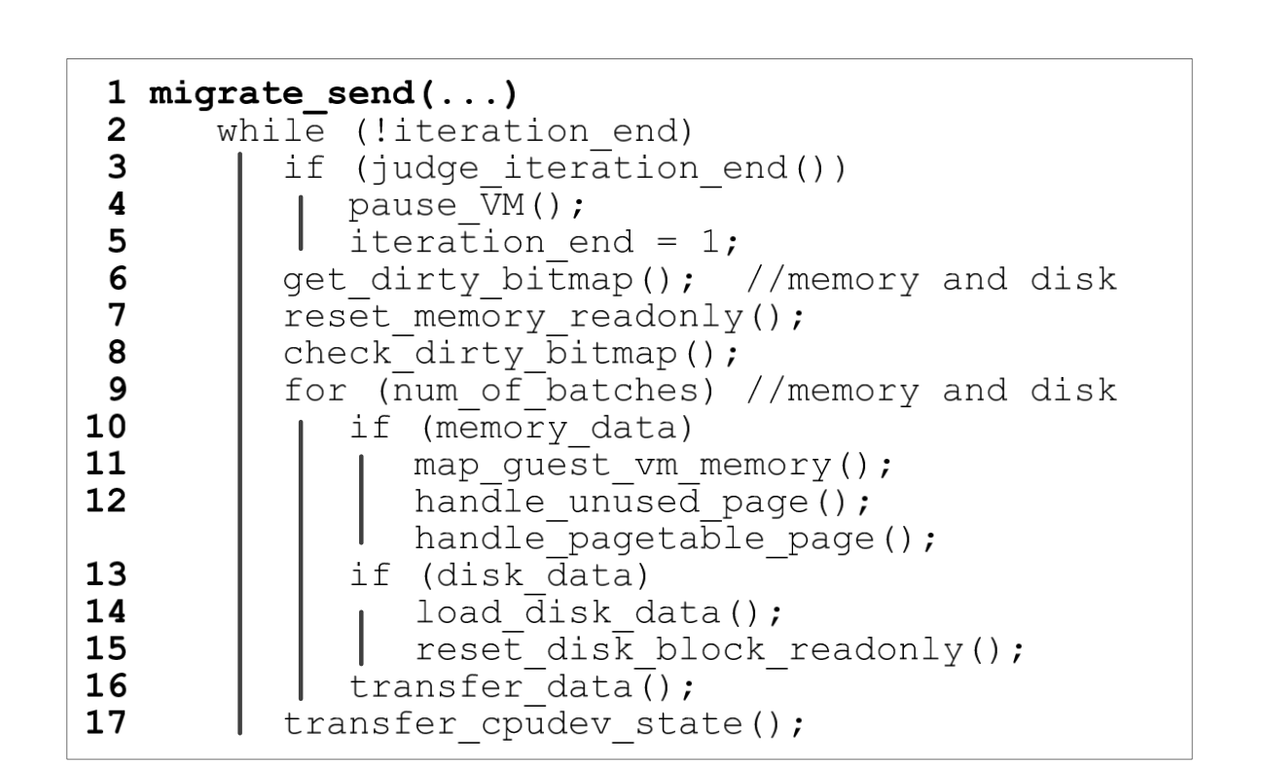
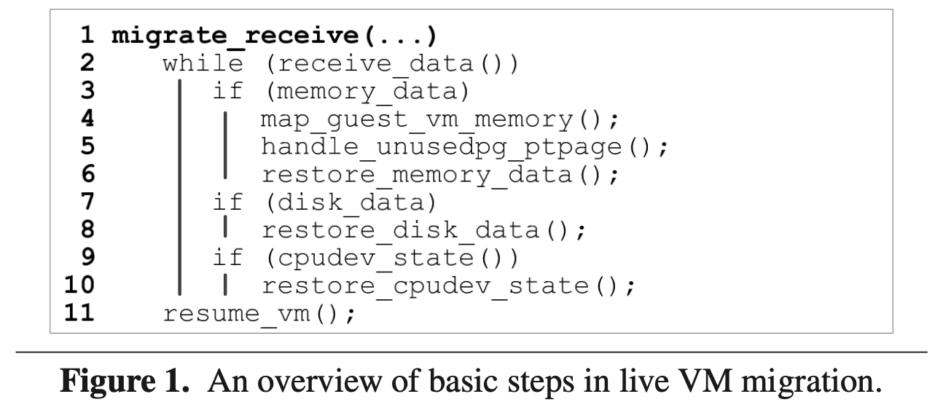
Live Migration Pseudo-code
Treat disk data and memory data in the same way!

Slide 23
Analysis of Parallelism
Data parallelism
No dependency among different portions of memory and disk data in the same iter- ation
e.g. Resetting disk data into readonly, mapping guest VM memory pages into the address space of the management tool, processing unused pages and page table pages, transferring memory and disk data and restoring memory data
Pipeline Parallelism
Partition an operation into a number of stages
e.g. Read disk -> send disk data

Slide 24
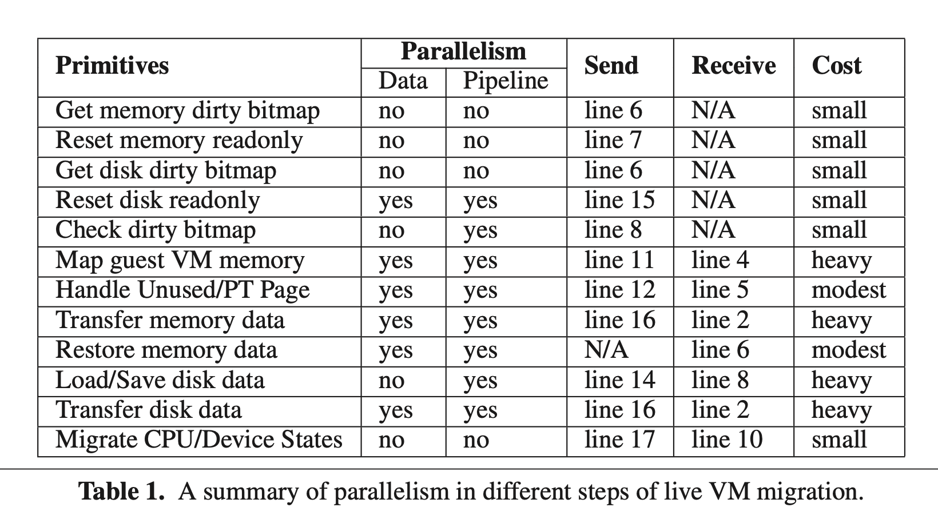
Analysis of Parallelism

Slide 25
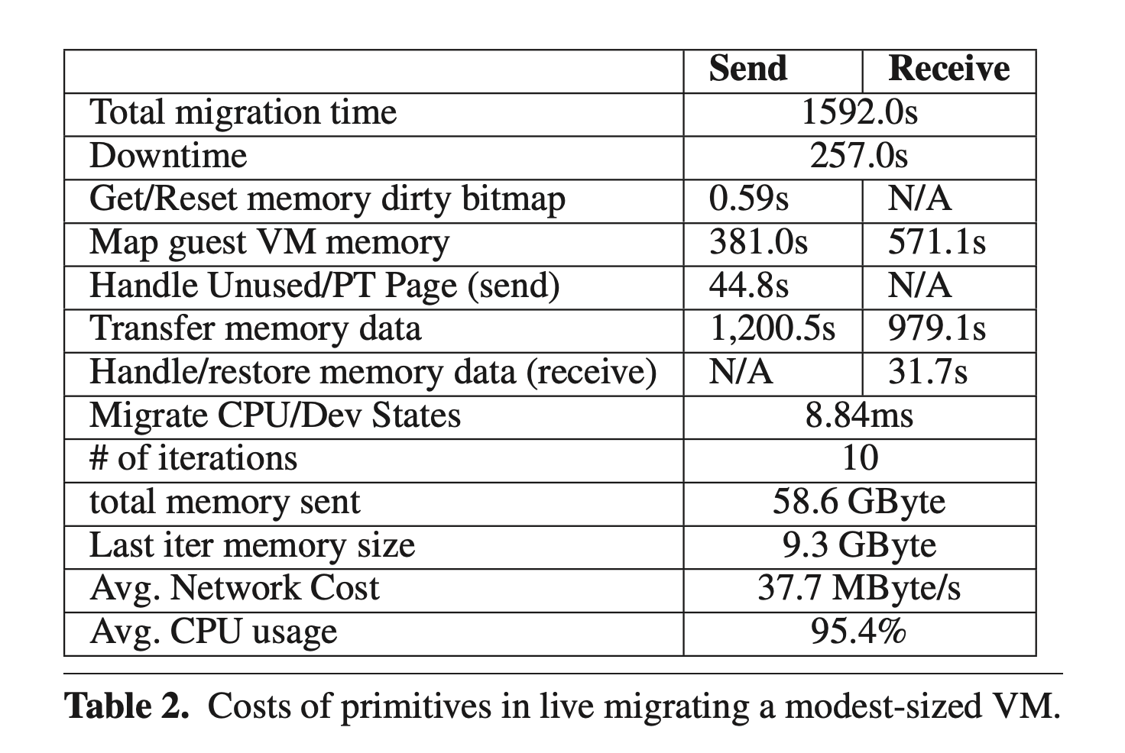
Analysis of Parallelism
A modest-sized VM with 16 GByte memory, 4 virtual CPUs and 16 GByte disk
Run a memcached server on the guest VM with modest workload

Slide 26
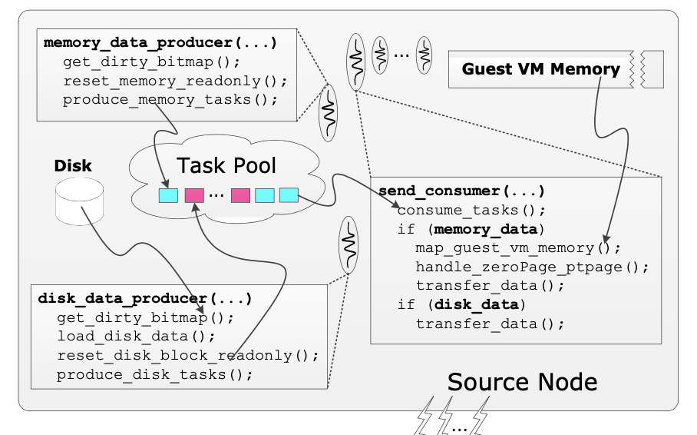
Parallelization Pseudo-code
Source node
One mem_task producer thread per iter
One disk_task producer thread per iter
Several consumer threads
Gain a parallelization for most time-consuming operations
Read from disk in disk_data_producer() as disk I/O itself is serialized

Slide 27
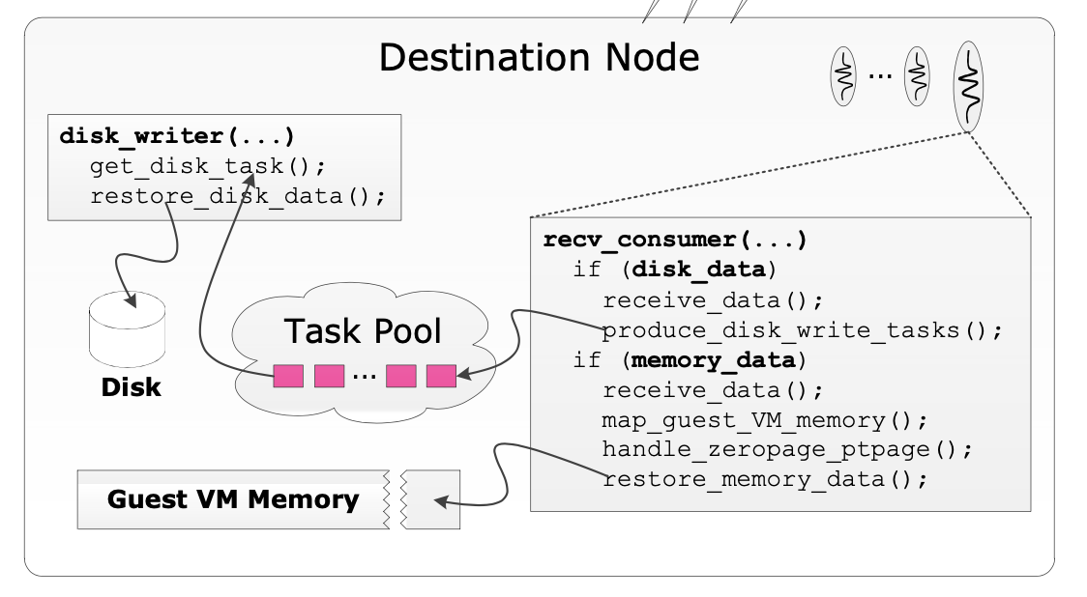
Parallelization Pseudo-code
Destination node
Several consumer threads
Pipeline disk data transfer operation by partitioning it into
receive_data()
restore_disk_data()
Receive and restore CPU and device states and resuming the VM

Slide 28
Resource Usage Control
Network Rate Control in Live Migration
A network monitor daemon is spawned to collect the network usage(both src and dst)
Only use spare bandwidth, and set a minimum bandwidth
CPU Rate Control
By upgrading/downgrading migration process priority
By default, below avg
Limiting Memory Consumption
Dst may need a memory pool to store data which is not consumed
Limit the memory pool size and block allocation

Slide 29
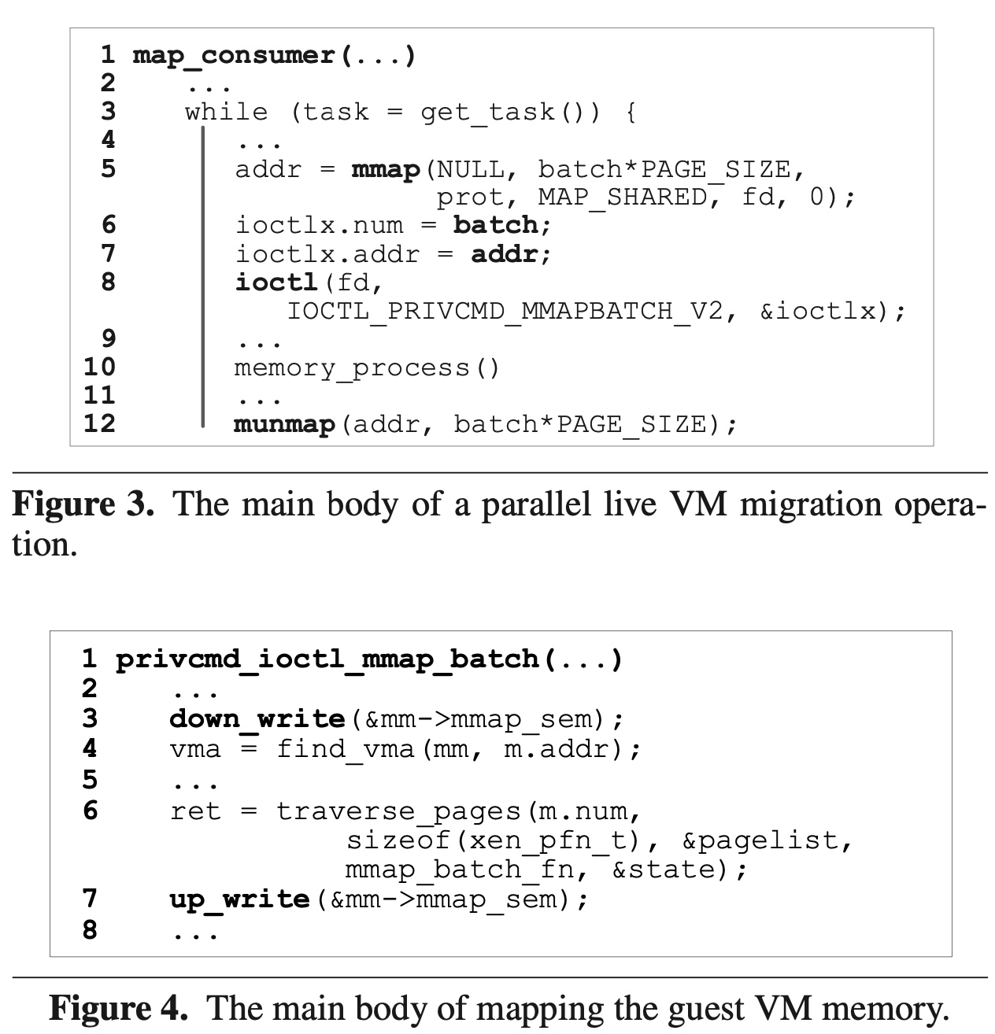
Scaling Mutation to Kernel Address Space
A serious kernel serialization
mmap/munmap operations serialized by most existing OS kernel
more than 8.91%, 22.94% and 16.08% of total migration time is spent within mmap_sem()
Holding mmap_sem() in write mode is largely unnecessary
Only protects a private Xen-specific field in the VMA
the mmap sem can be hold in read mode with a fine-grained lock to protect the field.

Slide 30
Range Lock
Protect only the requesting ranges of an address space
Use a skip list to maintain in-use memory regions (O(log n) insert delete search)

Slide 31
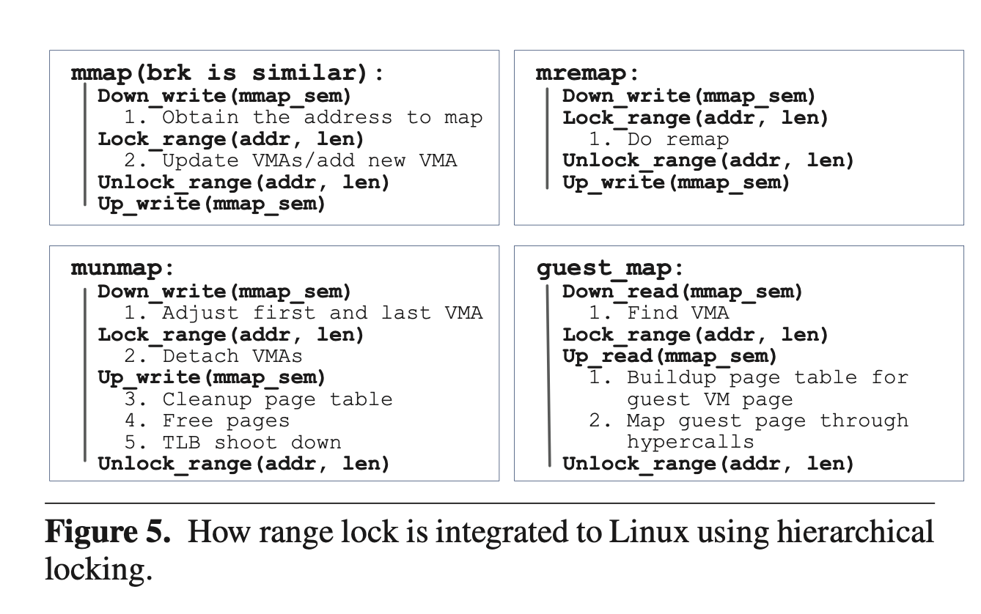
Range Lock
Little change to kernel
Comprises of 290 SLOCs
Related change to Linux is 120 SLOCs
only uses range_lock to parallelize the time-consuming parts, leaving kernel data structures intact (vm_area_struct)

Slide 32
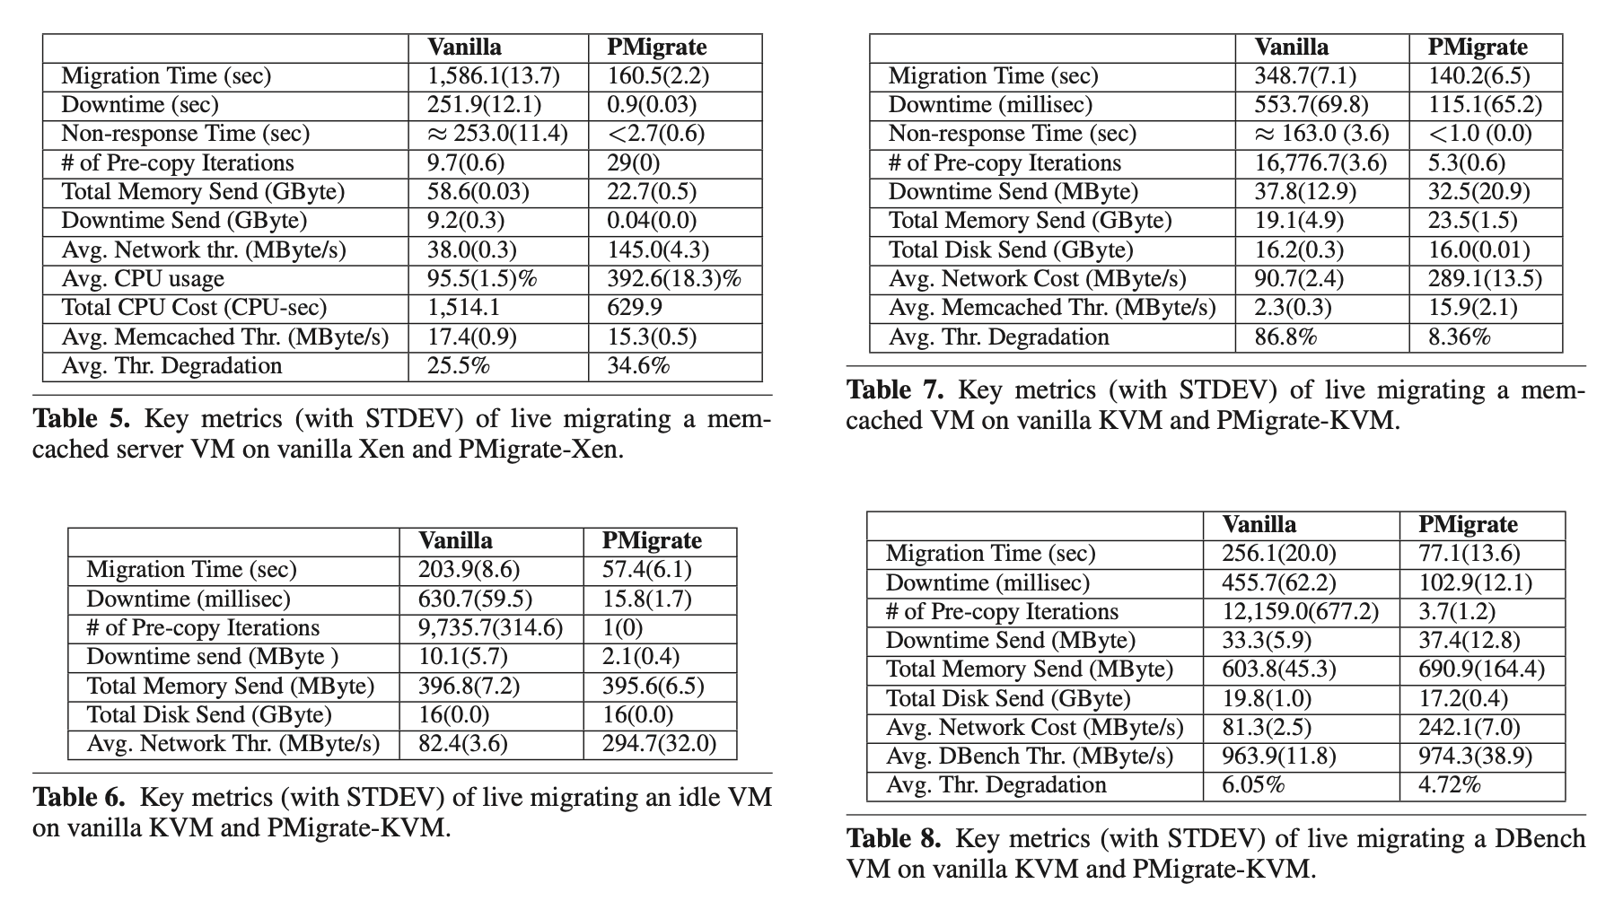
Speed up

Slide 33
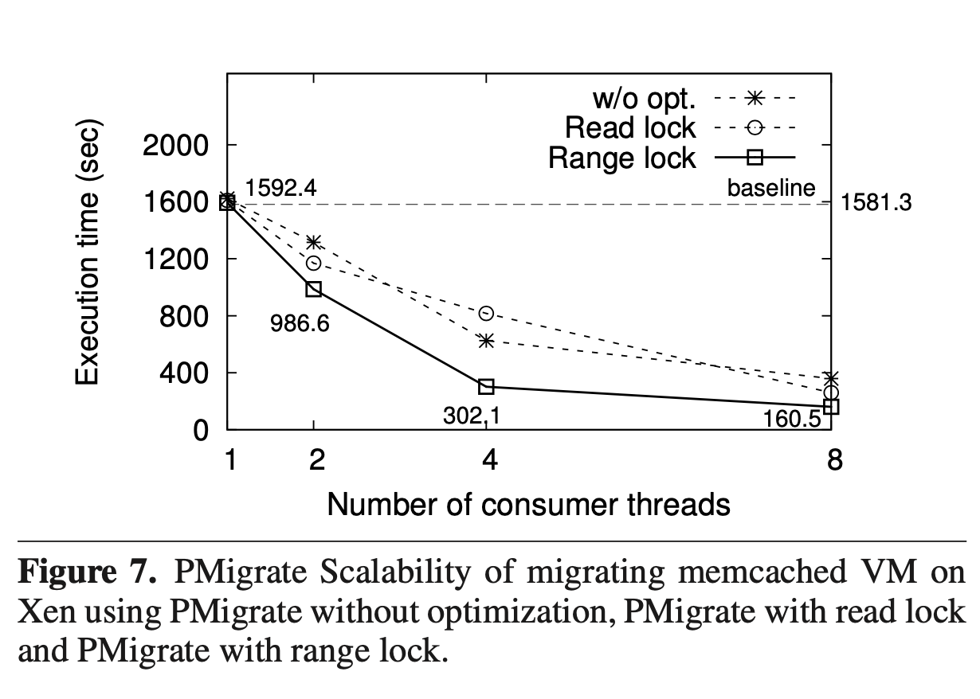
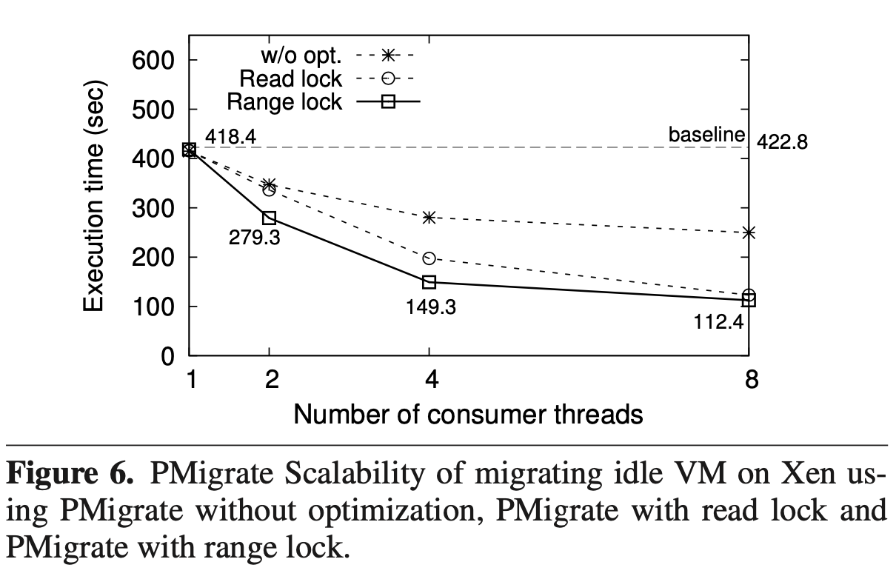
Scalability

Slide 34
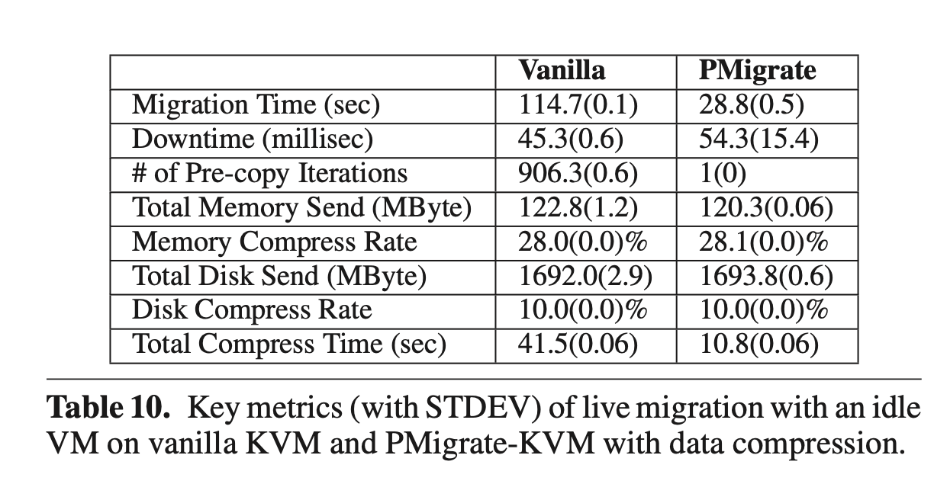
Combining PMigrate with Compression

Slide 35
Q & A

